Slide 1
FINAL PROJECT REPORT ON “BLOOD BANK MANAGEMENT SYSTEM”
BACHELOR OF ENGINEERING IN
COMPUTER SCIENCE & ENGINEERING
Submitted to: Er JYOTI ARORA

Slide 2
Submitted By:
DIBYAJYOTI DEV RAY (20BCS2860)
RITIK CHAUHAN (20BCS2849)

Slide 3
Contents
CLASS A (BRIEF INRO & REQUIREMENTS)
CLASS B (SCOPE OF THE PROJECT)
CLASS C (RESULTS)
CLASS D (FUTURE SCOPE)

Slide 4
CLASS A BRIEF INTRODUCTION
BLOOD BANK MANAGEMENT SYSTEM is a ‘WEBSITE’ designed to maintain day to day transactions in a blood bank. This website helps to register all the donors, Blood collection details etc. Blood banks collect, store, and provide blood. Typically, these banks collect blood from voluntary blood donors. The banks then sort blood by type, check blood to make sure it is free of disease and then store it for future use. The main mission of a blood bank is to provide life-saving blood to hospitals and other health care facilities. Blood cannot be created by any means, it can only be collected from the Humans i.e., donors. A blood bank is a bank of blood or blood components, gathered as a result of blood donation, stored and preserved for later use in blood transfusion. To satisfy blood necessity, to buy, sale and stock.
What the purpose?
Online Blood Bank aims to serving for human welfare. We have all the information; you will need. It is very easy to use. It saves a lot of time. The portal acts as an office that is open 24/7
Many people are ready to help you, willing to donate blood for you anytime. Search the blood group you need. You can help us by registering on Online Blood Bank if you are willing to donate your blood when needed. As a proud member of Blood Bank and a responsible human being, you can help someone in need. So, donate blood in online.

Slide 5
Requirements
Software:
HTML
HTML stands for Hyper Text Markup Language. It is the standard markup language for creating Web pages. It describes the structure of a Web page. It consists of a series of elements. HTML elements tell the browser how to display the content.HTML elements label pieces of content such as “this is a heading”, “this is a paragraph”, “this is a link”, etc.
Hypertext Markup Language (HTML) is the standard markup language for documents designed to be displayed in a web browser. It can be assisted by technologies such as Cascading Style Sheets (CSS) and scripting languages such as JavaScript
CSS
CSS stands for Cascading Style Sheets. CSS describes how HTML elements are to be displayed on screen, paper, or in other media. CSS saves a lot of work. It can control the layout of multiple web pages all at once. External stylesheets are stored in CSS files

Slide 6
PHP
PHP is a general-purpose scripting language that is especially suited to web development. It was originally created by Danish-Canadian programmer Rasmus Lerdorf in 1994; the PHP reference implementation is now produced by The PHP Group. PHP originally stood for Personal Home Page,[7] but it now stands for the recursive initialism PHP: Hypertext Preprocessor.
MY SQL
SQL is a standard language for accessing and manipulating databases. SQL stands for Structured Query Language. SQL lets you access and manipulate databases. SQL became a standard of the American National Standards Institute (ANSI) in 1986, and of the International Organization for Standardization (ISO) in 1987
SQL can execute queries against a database, retrieve data, insert records in a database, update records, delete records, create new databases, create new tables in a database, create stored procedures in a database, create views in a database, set permissions on tables, procedures, and views

Slide 7
Class B SCOPE OF THE PROJECT
In this project mainly 2 modules are there.
1. Admin
2. Donor
Definitions
Donor: The person who donate the blood
Admin: Person who ensures of keeping a website running efficiently and securely

Slide 8
Admin:
This module focuses on the admin only. Each member in a admin is asked make a user id and password, which identifies him uniquely. The member is given a login form. he enters the login details user id and password. The options given to the user are
•Maintain donor details
•Update donor details
•Maintain Visitors Experiences
•Logout/Login
Change Password
Whenever a user wants to change his / her password he can select the forgot password option. The system displays the form, which asks him for his old password and new password. The system then compares the old password with the existing password in the database
Donor:
Each member in a Donor is given a user id and password, which identifies him uniquely. The member is given a login form. he enters the login details user id and password. The options given to each member are Change password.

Slide 9
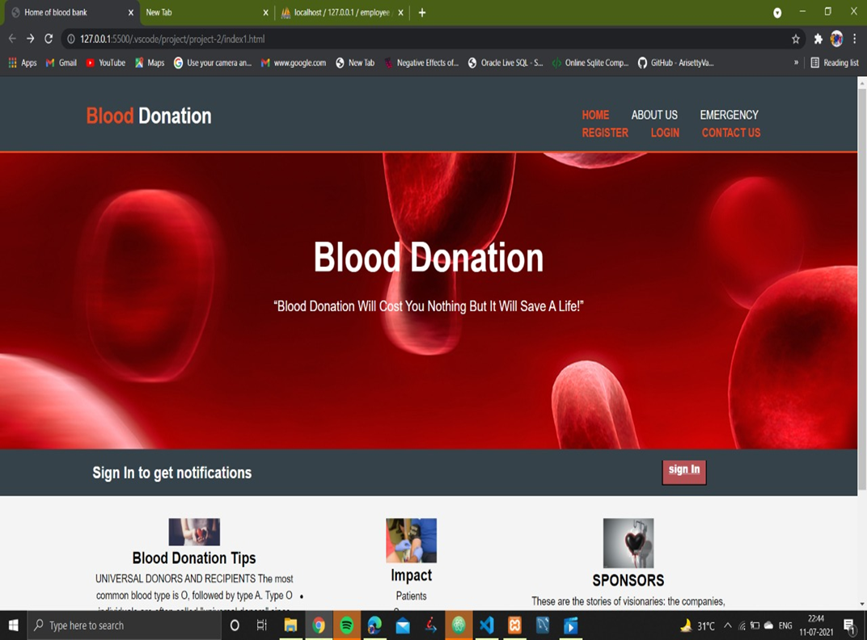
Class C Results

Slide 10
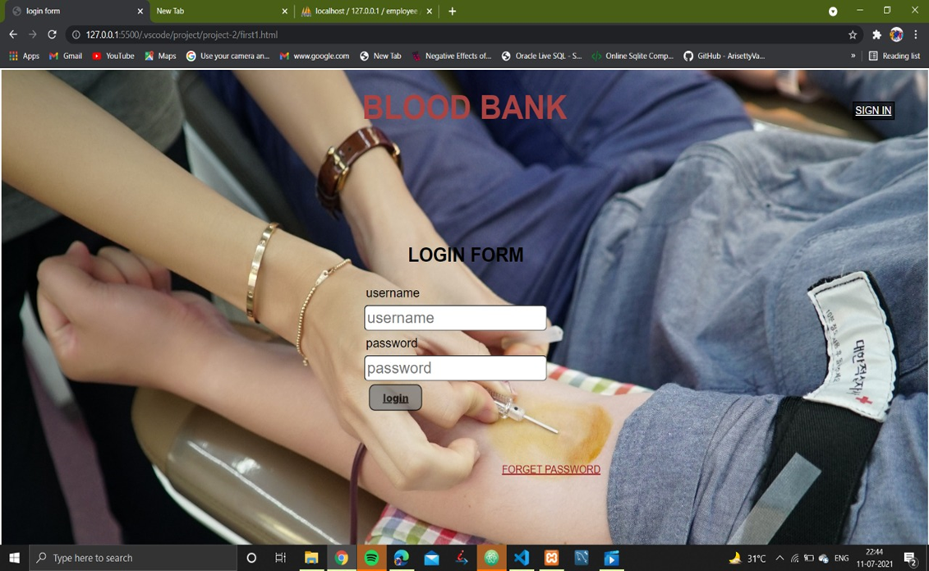
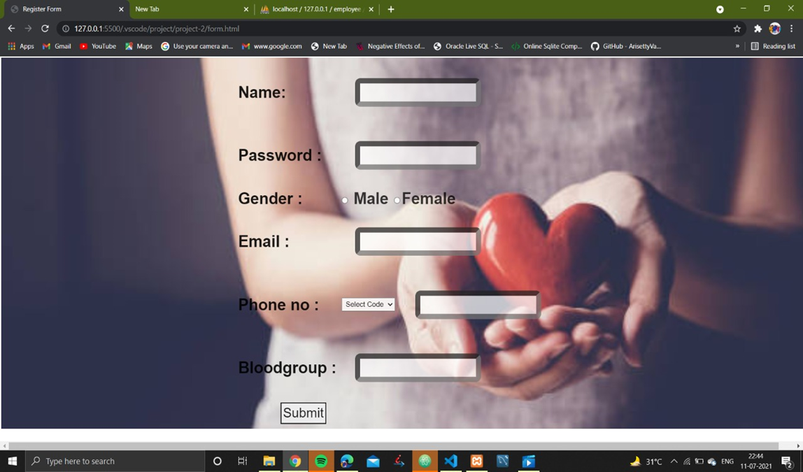
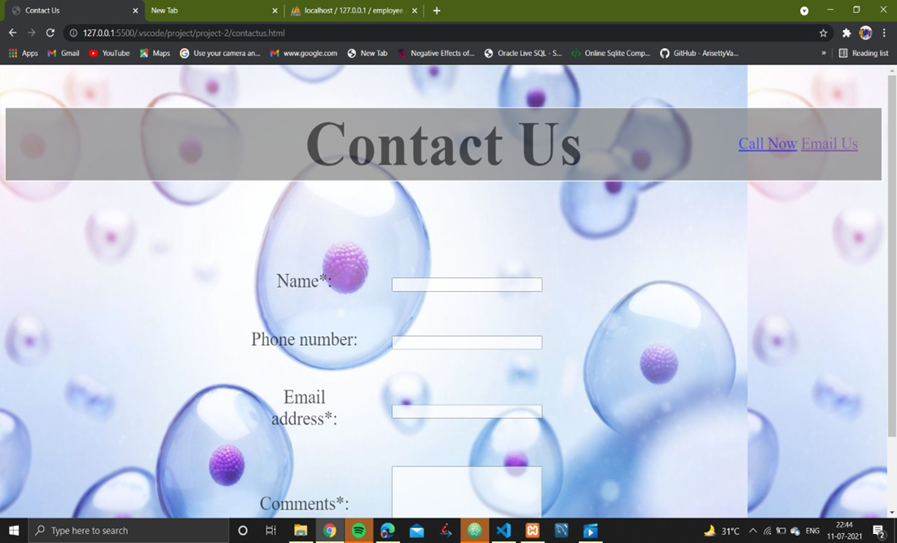
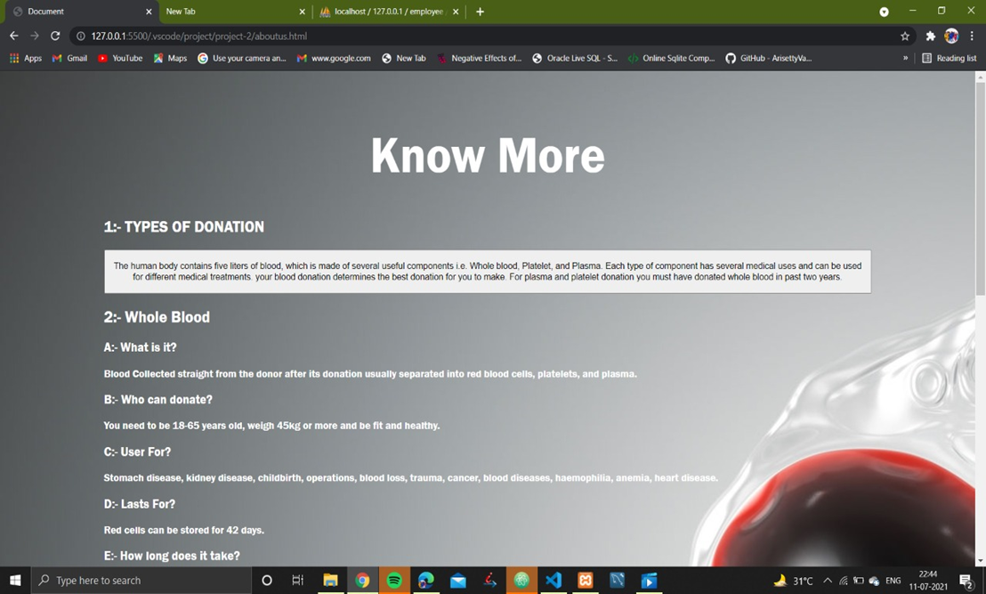

Slide 11
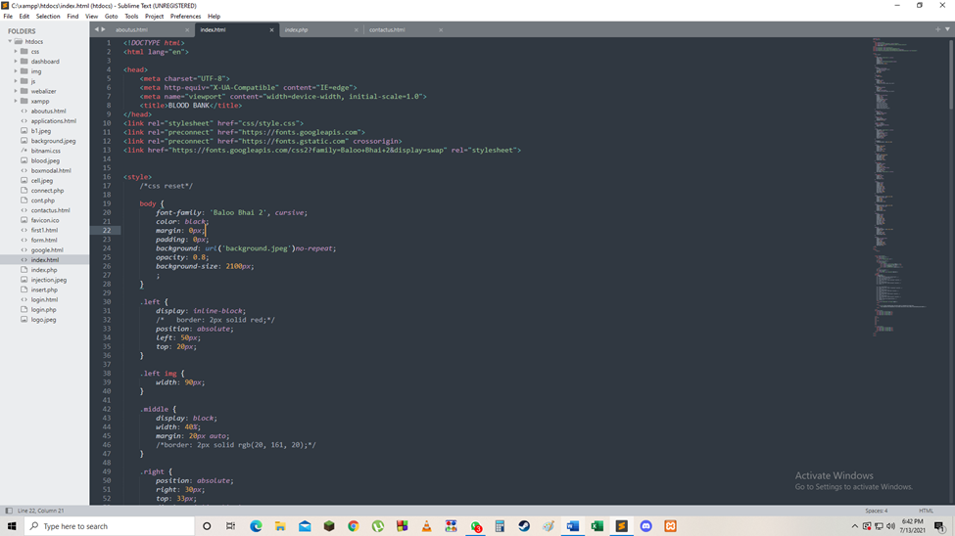
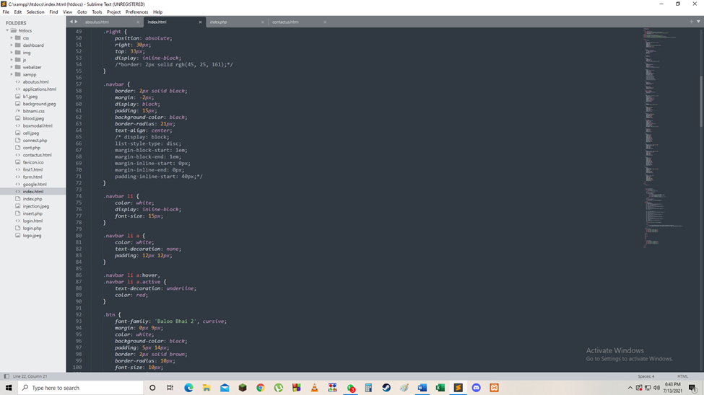
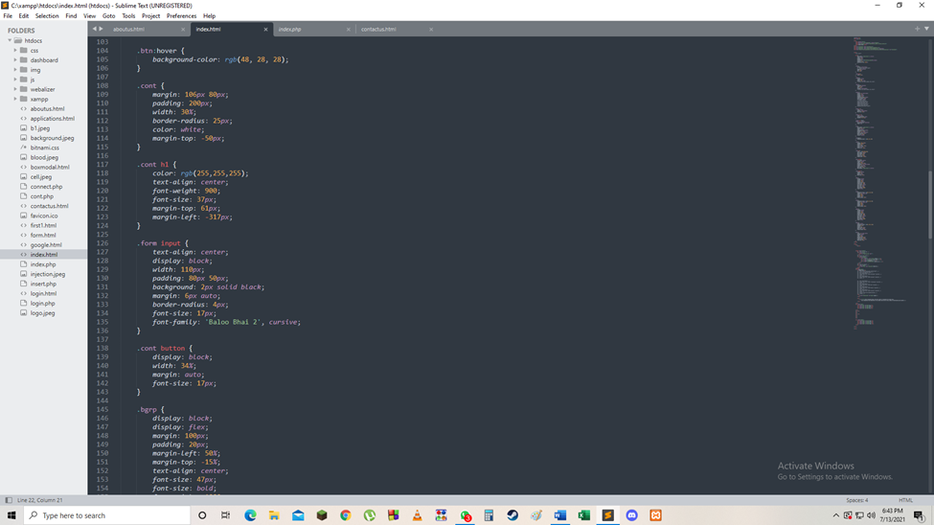
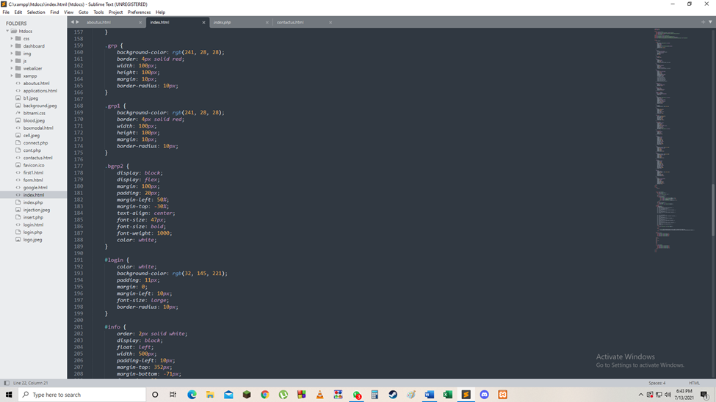
Code:

Slide 12
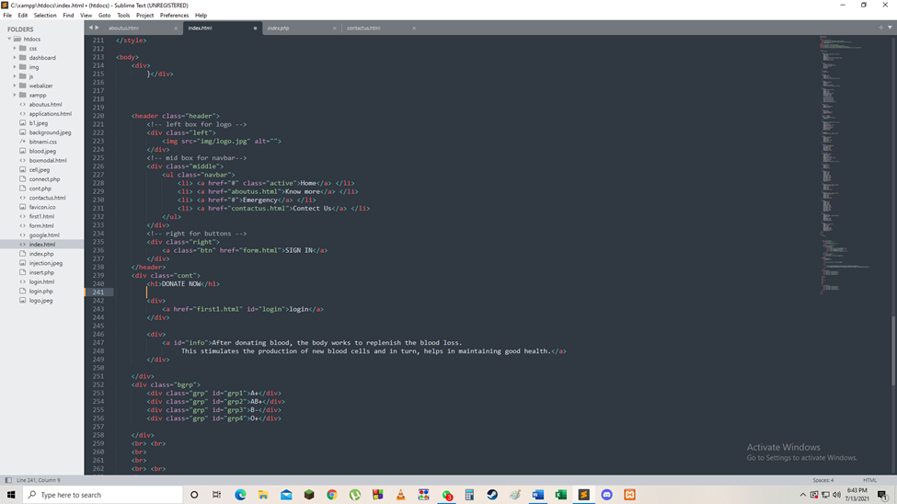
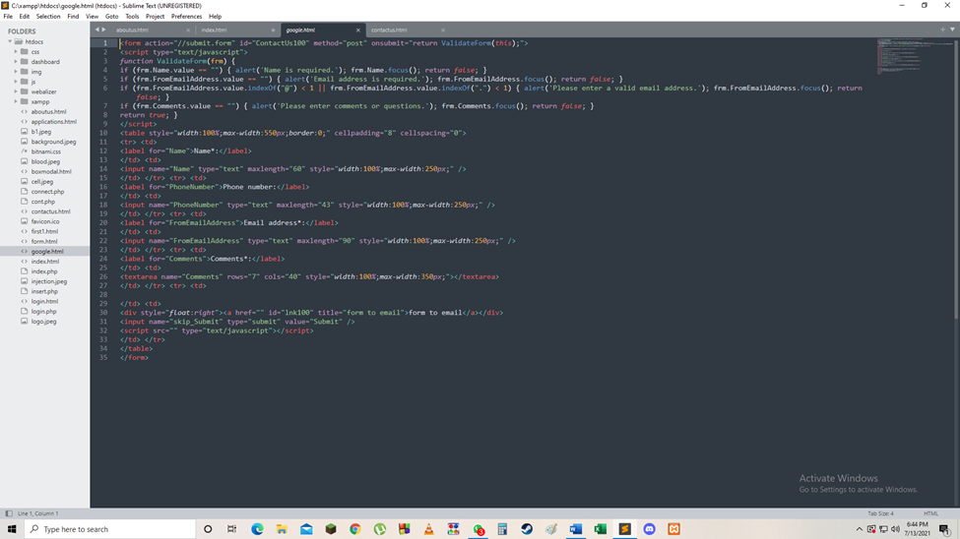
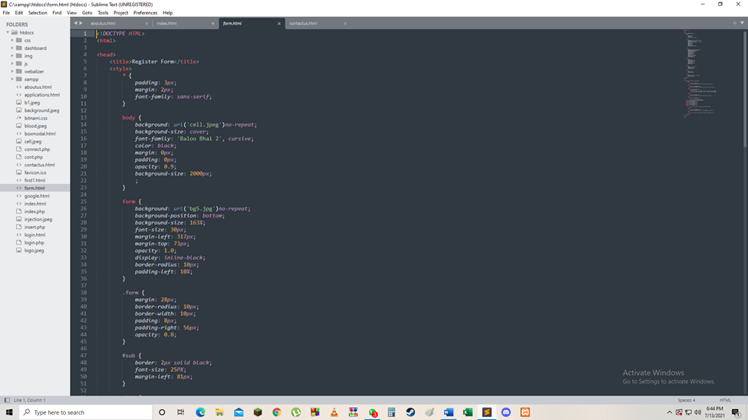
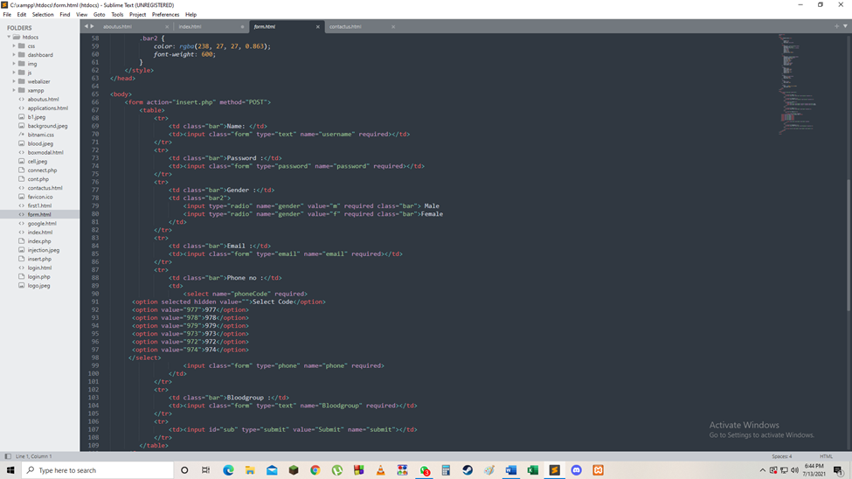
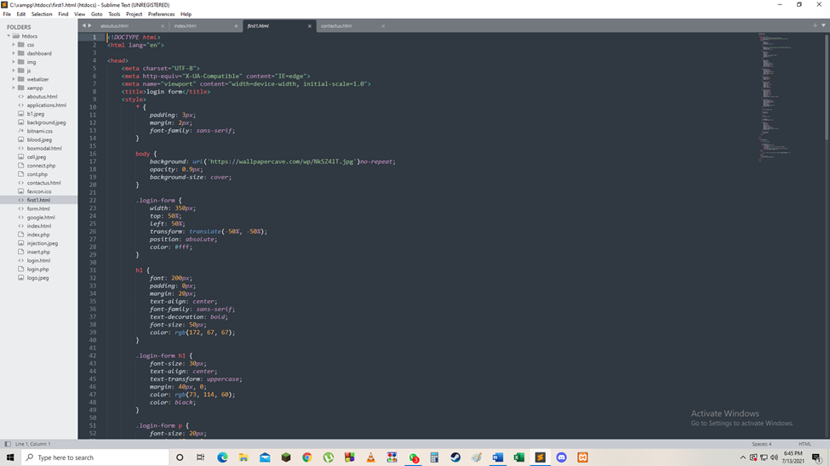
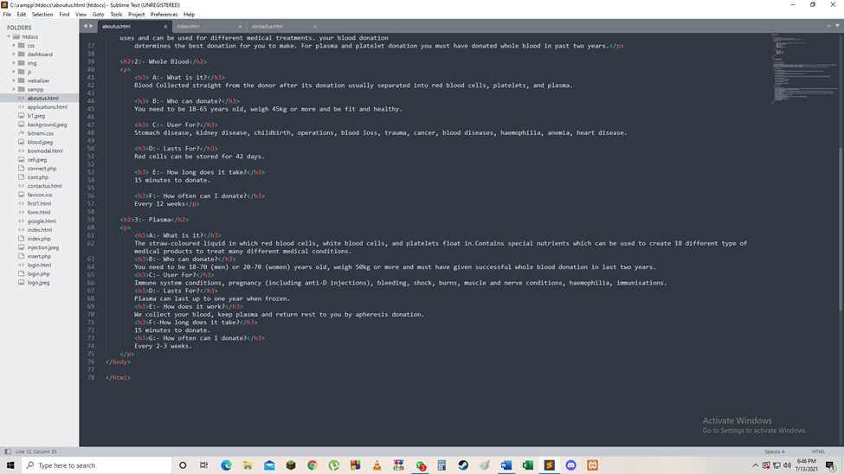
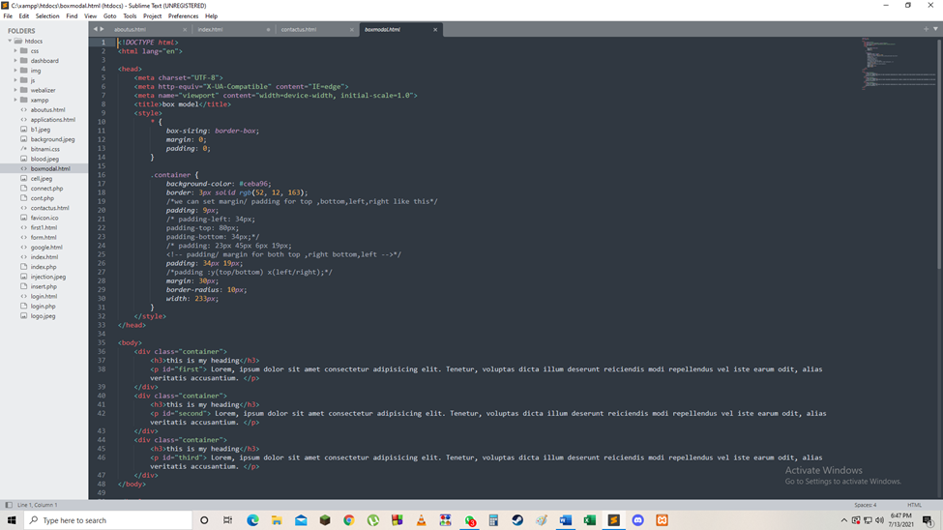
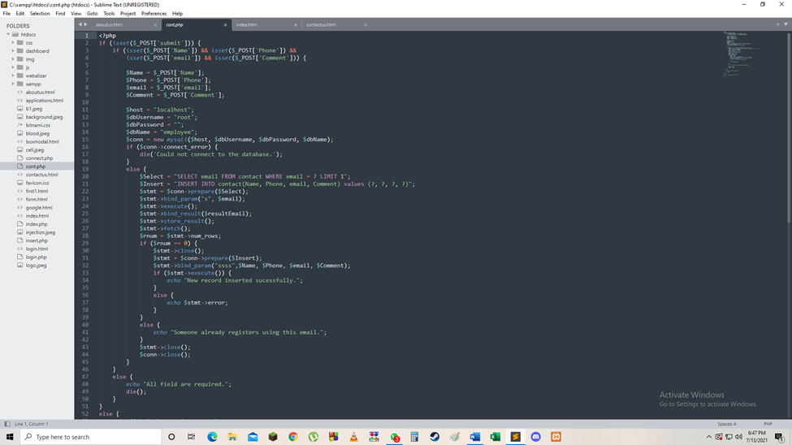

Slide 13
Class D Future scope
Although it’s a fully working model there are still a lot of improvements to be made such as
• Putting up more information about other blood banks located near the user in India as well as in abroad
• Putting Ai’s bot feature to interact with the user to guide him /her how to operate the website and to clear doubts.

